Slide 1
Medicaid and Food Security 101
A video series from the Medicaid Food Security Network

Slide 2
Module 0:
Introduction to the Series

Slide 3
You can find ancillary resources in the video description or below each video on the website.

Slide 5
What Does Food Have to Do With Health?

Slide 6
Why Engage Medicaid Agencies, Plans, and Providers to Address Food Insecurity?

Slide 7
34 Million Children and Youth
Medicaid Enrollment
51 Million Adults
Source: July 2023 Medicaid and CHIP Enrollment Snapshot, CMS

Slide 8
$626 Billion
$111 Billion
Annual Medicaid Expenditures
Annual SNAP Expenditures
Sources:
Medicaid Expenditures: Centers for Medicare & Medicaid Services. (n.d.). Annual Medicaid & CHIP expenditures. Medicaid.gov. Retrieved October 23, 2023, from https://www.medicaid.gov/state-overviews/scorecard/annual-medicaid-chip-expenditures/index.html
SNAP Expenditures: Center on Budget and Policy Priorities. (2022, June 9). Policy basics: The Supplemental Nutrition Assistance Program (SNAP). Retrieved October 23, 2023, from https://www.cbpp.org/research/food-assistance/the-supplemental-nutrition-assistance-program-snap
Annual Food Costs: Consumer expenditures--2022. (2023, September 8). U.S. Bureau of Labor Statistics. Retrieved October 23, 2023, from https://www.bls.gov/news.release/cesan.nr0.htm

Slide 9
Objectives: Upon completion of the training, participants will have knowledge and resources that will enable them to:
Explain the basic structure of the Medicaid program, including eligibility and benefits, delivery and financing, and the program’s impact on food insecurity, healthcare utilization, and health outcomes
Coming Up:
Module 1: Introduction to Medicaid
Module 2: Medicaid Eligibility and Benefits
Module 3: Food Insecurity and Healthcare Utilization and Health Outcomes
Module 4: Medicaid Delivery Systems and Financing
Module 5: Medicaid Policy Levers to Address Social Needs
We recommend that you go through the training in order, but you are welcome to review just the modules that are most interesting to you.

Slide 10
Objectives: Upon completion of the training, participants will have knowledge and resources that will enable them to:
Explain the basic structure of the Medicaid program, including eligibility and benefits, delivery and financing, and the the program’s impact on food insecurity, healthcare utilization, and health outcomes
Coming Up:
Module 1: Introduction to Medicaid
Module 2: Medicaid Eligibility and Benefits
Module 3: Food Insecurity and Healthcare Utilization and Health Outcomes
Module 4: Medicaid Delivery Systems and Financing
Module 5: Medicaid Policy Levers to Address Social Needs
We recommend that you go through the training in order, but you are welcome to review just the modules that are most interesting to you.

Slide 11
Objectives: Upon completion of the training, participants will have knowledge and resources that will enable them to:
Explain the basic structure of the Medicaid program, including eligibility and benefits, delivery and financing, and the the program’s impact on food insecurity, healthcare utilization, and health outcomes
Coming Up:
Module 1: Introduction to Medicaid
Module 2: Medicaid Eligibility and Benefits
Module 3: Food Insecurity and Healthcare Utilization and Health Outcomes
Module 4: Medicaid Delivery Systems and Financing
Module 5: Medicaid Policy Levers to Address Social Needs
We recommend that you go through the training in order, but you are welcome to review just the modules that are most interesting to you.

Slide 12
Objectives: Upon completion of the training, participants will have knowledge and resources that will enable them to:
Explain the basic structure of the Medicaid program, including eligibility and benefits, delivery and financing, and the the program’s impact on food insecurity, healthcare utilization, and health outcomes
Coming Up:
Module 1: Introduction to Medicaid
Module 2: Medicaid Eligibility and Benefits
Module 3: Food Insecurity and Healthcare Utilization and Health Outcomes
Module 4: Medicaid Delivery Systems and Financing
Module 5: Medicaid Policy Levers to Address Social Needs
We recommend that you go through the training in order, but you are welcome to review just the modules that are most interesting to you.

Slide 13
Objectives: Upon completion of the training, participants will have knowledge and resources that will enable them to:
Explain the basic structure of the Medicaid program, including eligibility and benefits, delivery and financing, and the the program’s impact on food insecurity, healthcare utilization, and health outcomes
Coming Up:
Module 1: Introduction to Medicaid
Module 2: Medicaid Eligibility and Benefits
Module 3: Food Insecurity and Healthcare Utilization and Health Outcomes
Module 4: Medicaid Delivery Systems and Financing
Module 5: Medicaid Policy Levers to Address Social Needs
We recommend that you go through the training in order, but you are welcome to review just the modules that are most interesting to you.

Slide 14
Objectives: Upon completion of the training, participants will have knowledge and resources that will enable them to:
Explain the basic structure of the Medicaid program, including eligibility and benefits, delivery and financing, and the the program’s impact on food insecurity, healthcare utilization, and health outcomes
Coming Up:
Module 1: Introduction to Medicaid
Module 2: Medicaid Eligibility and Benefits
Module 3: Food Insecurity and Healthcare Utilization and Health Outcomes
Module 4: Medicaid Delivery Systems and Financing
Module 5: Medicaid Policy Levers to Address Social Needs
We recommend that you go through the training in order, but you are welcome to review just the modules that are most interesting to you.

Slide 15
Leaving Module 0
Find your state’s Medicaid website and learn what your Medicaid program is called.

Slide 16
Module 1:
Introduction to Medicaid

Slide 17
Healthcare Coverage in the United States

Slide 18
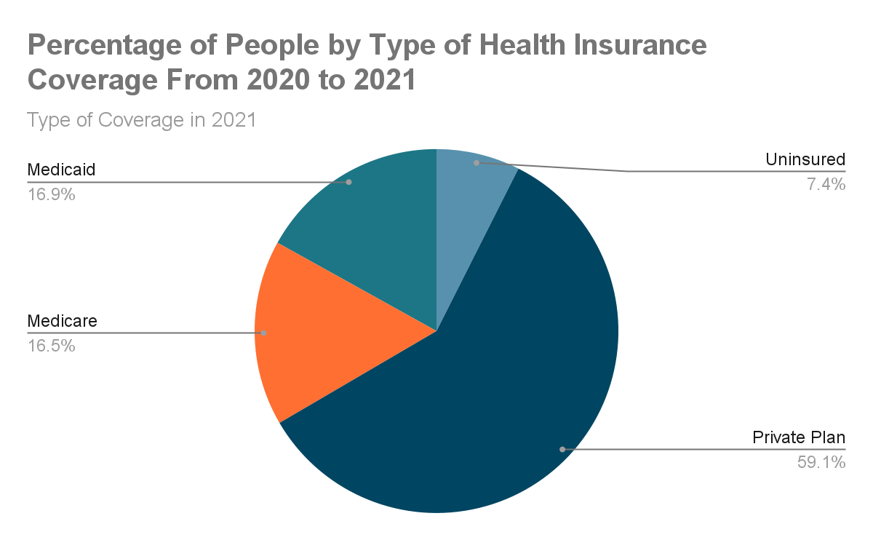
Source: U.S. Census Bureau, Current Population Survey, 2021 and 2022 Annual Social and Economic Supplements (CPS ASEC).

Slide 19
A Brief History of Medicaid
Medicaid and Medicare enacted in 1965
Federal government contributes significant funds to each state Medicaid program
States must comply with laws and regulation set by the federal Centers for Medicare and Medicaid Services (CMS)
Medicaid is an optional program but all states now offer it
President Johnson signing the Medicare program into law, July 30, 1965 Photo courtesy of LBJ Presidential Library

Slide 20
Medicaid and Food

Slide 21
Many organizations are now investing in food and health including…
Gus Schumacher Nutrition Incentive Program (GusNIP)
Tufts Food Is Medicine Institute
Food is Medicine Coalition
Elevance Health Foundation
Rockefeller Foundation
American Heart Association
White House Conference on Hunger, Nutrition & Health
HHS Food is Medicine Summit
National Produce Prescription Collaborative
Share Our Strength
H. Jack Geiger opens clinic that prescribes food to malnourished families, 1967

Slide 22
Food and Nutrition Security
Food Security
When all people, at all times, have physical and economic access to sufficient safe and nutritious food that meets their dietary needs and food preferences for an active and healthy life.
Nutrition Security
Consistent and equitable access to healthy, safe, affordable foods essential to optimal health and well-being.

Slide 23
Leaving Module 1
Key Takeaway
Learn More:
Visit Feeding America’s Map the Meal Gap website and consider deepening your knowledge about food insecurity among Medicaid enrollees in your state.
How might you support and elevate the voice and stories of Medicaid enrollees experiencing food insecurity?
Medicaid is evolving and there is long history of discussion around food and Medicaid.

Slide 24
Module 2:
Medicaid Eligibility and Benefits

Slide 25
Medicaid Enrollment:
Eligibility and Expansion

Slide 26
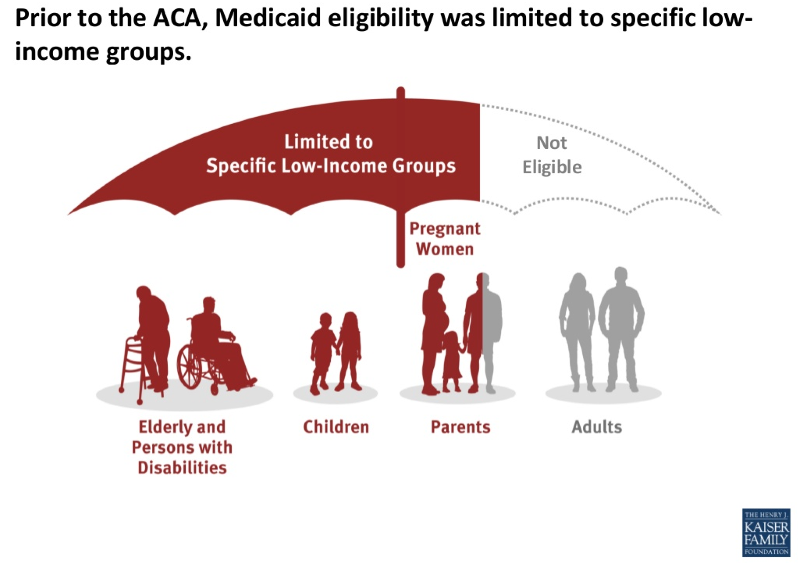

Slide 27
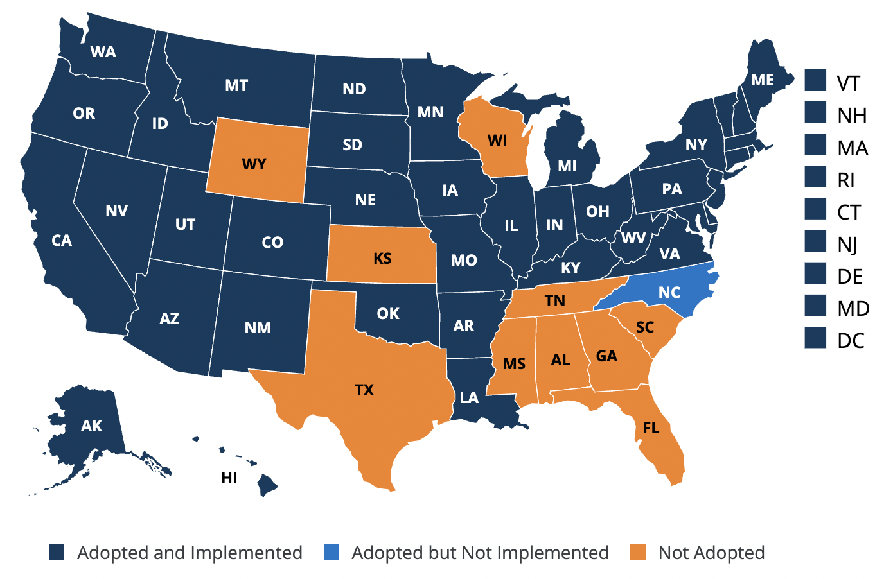
Status of Medicaid Expansion as of Sept 2023
Source: Status of State Medicaid expansion Decisions: Interactive Map | KFF. (2023, September 26). KFF. https://www.kff.org/medicaid/issue-brief/status-of-state-medicaid-expansion-decisions-interactive-map/

Slide 28
Medicaid Enrollment:
A Cross-Section of America

Slide 29
Examples of Medicaid Mandatory Benefits
Inpatient hospital services
Outpatient hospital services
EPSDT: Early and Periodic Screening, Diagnostic, and Treatment Services
Nursing Facility Services
Home health services
Physician services
Laboratory and X-ray services
Family planning services

Slide 30
Early and Periodic Screening, Diagnostic and Treatment
The regulation says:
“...early and periodic screening and diagnosis of eligible Medicaid beneficiaries under age 21 to ascertain physical and mental defects, and providing treatment to correct or ameliorate defects and chronic conditions found”
Which means:
Any service that is medically required to promote a child’s health and well-being should be covered under Medicaid

Slide 31
Medicaid and Food Insecurity

Slide 32
SNAP and Health Outcomes
Participants more likely to report excellent or very good health than low-income non-participants.
Low-income SNAP participants incur nearly 25% less in medical costs each year than low-income non-participants.
Source: SNAP Is Linked With Improved Health Outcomes and Lower Health Care Costs. (2022, December 14). CBPP. https://www.cbpp.org/research/food-assistance/snap-is-linked-with-improved-health-outcomes-and-lower-health-care-costs

Slide 33
The WIC program covers…
Foods to supplement diet, including:
Baby food
Fruits and vegetables
Whole grain breads and cereals
Other resources and supports:
Health screening
Nutrition and breastfeeding counseling
Immunization screening and referral
Substance use referral
Source:WIC Fact Sheet, https://www.fns.usda.gov/wic/wic-fact-sheet
Notes:
Need citation

Slide 34
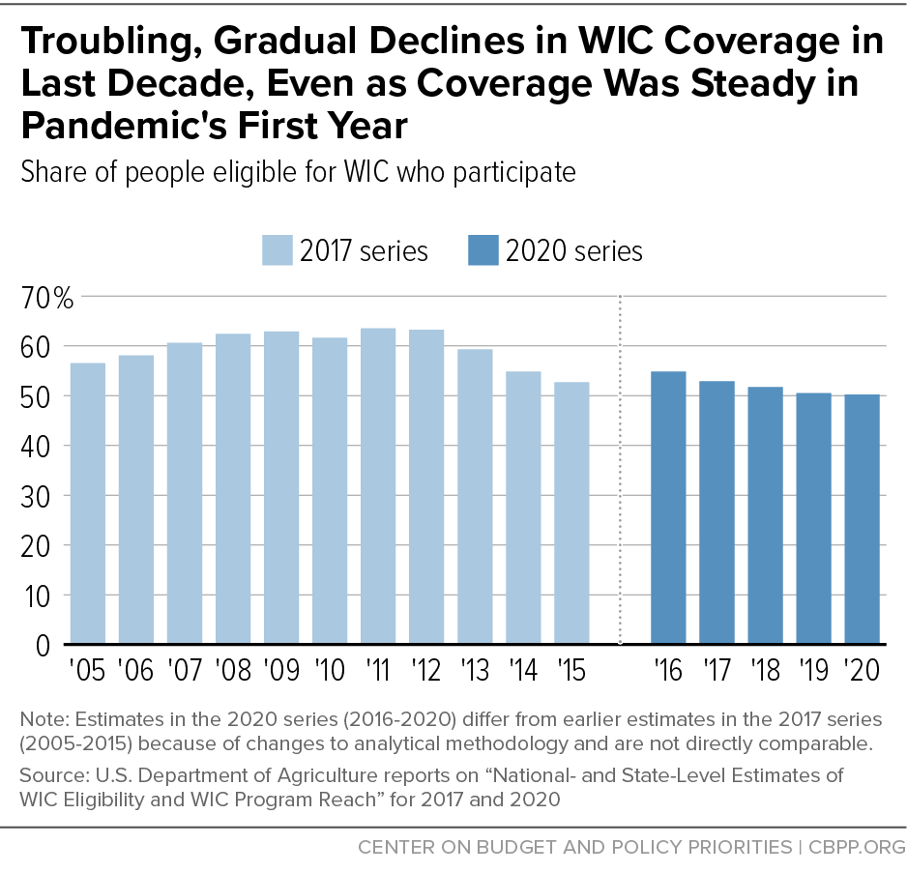
WIC Enrollment Gap
In 2020:
The monthly WIC-eligible population was 12.51 million people
The WIC enrollment rate was only 50.2%

Slide 35
Leaving Module 2
Key Takeaways
Each state has different criteria on who is eligible for Medicaid.
Medicaid benefits include a mandate to support treatments that address the health needs of children.
There are Medicaid enrollees who are eligible but not enrolled in SNAP and WIC.
There is an opportunity to connect Medicaid enrollees to SNAP and WIC.
Task:
Using the State Overview pages on the CMS website, find out who in your state can receive Medicaid and what benefits are covered.

Slide 36
Module 3:
Food Insecurity, Healthcare Utilization, and Health Outcomes

Slide 37
Why Should Medicaid Focus on Food?

Slide 38
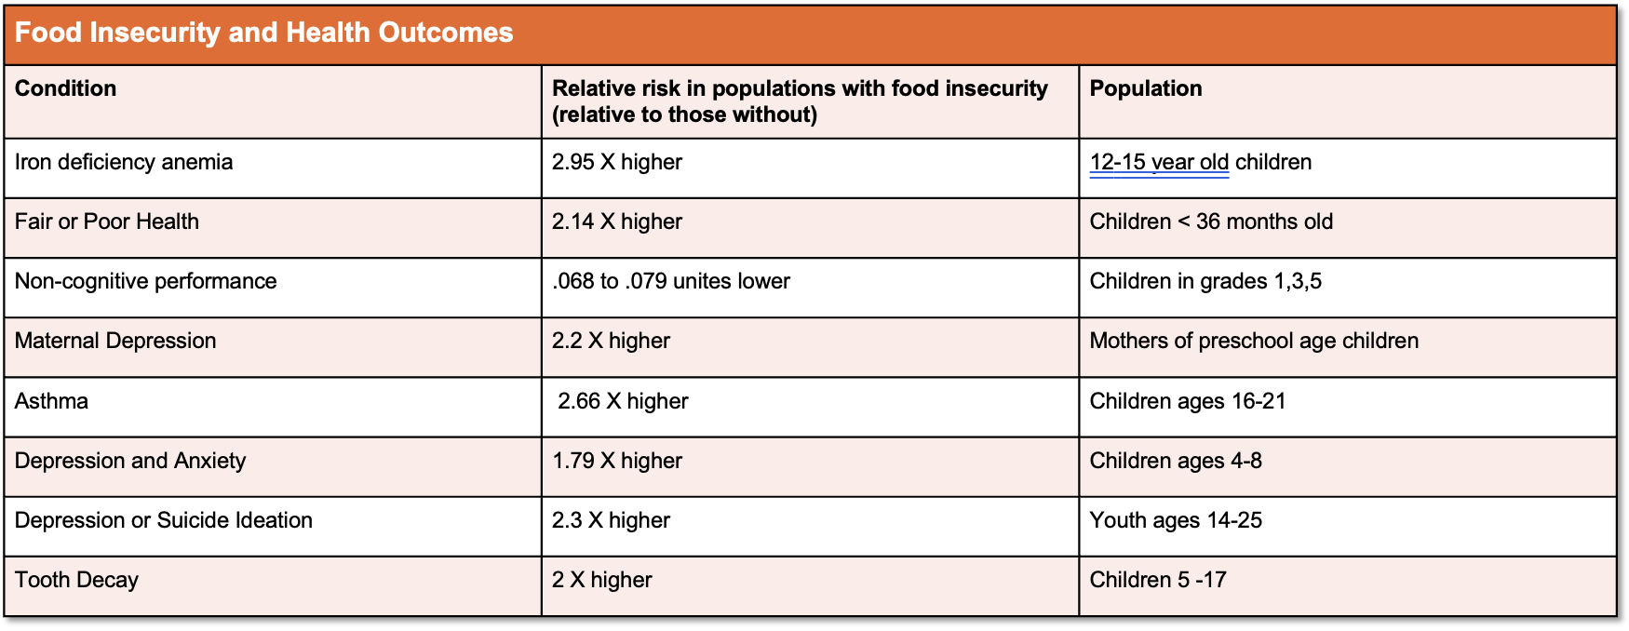
Source: Gundersen, C., & Ziliak, J. P. (2015). Food insecurity and health outcomes. Health Affairs, 34(11), 1830–1839. https://doi.org/10.1377/hlthaff.2015.0645

Slide 39
Food Insecurity and Healthcare Utilization

Slide 40
Food Insecurity and Healthcare Utilization
Food insecurity is correlated with higher healthcare utilization and costs in adults
Children experiencing food insecurity are more likely to use the Emergency Room and lack access to routine care
Gundersen, C., & Ziliak, J. P. (2015). Food Insecurity And Health Outcomes. Health Affairs, 34(11), 1830–1839. https://doi.org/10.1377/hlthaff.2015.0645
Peltz A and Garg A. Food Insecurity and Health Care Use. Pediatrics. 2019;144(4):e20190347

Slide 41
Food Insecurity and Health Equity

Slide 42
Food Insecurity and Health Equity
Food insecurity disproportionately affects Black and Hispanic households:
In 2020, Black non-Hispanic households were over 2 times more likely to be food insecure than the national average (21.7 percent versus 10.5 percent, respectively)
Among Hispanic households, the prevalence of food insecurity was 17.2 percent compared to the national average of 10.5 percent
Source: U.S. Department of Health and Human Services & Office of Disease Prevention and Health Promotion. (n.d.). Food insecurity. Healthy People 2030

Slide 43
Leaving Module 3
Key Takeaway
Build the Case:
What are your state’s Medicaid priorities around cost and utilization?
What would be the most impactful activities for the Medicaid agencies, payers or providers to engage in regarding food insecurity?
Food insecurity impacts health, health equity and healthcare costs and could be a critical way for Medicaid agencies, payers and providers to achieve their goals.

Slide 44
Module 4:
Medicaid Delivery Systems and Financing

Slide 45
Total Medicaid spending in FY 2021
$728 Billion
$728 Billion
Source: Total Medicaid Spending FY21, KFF
Source: Medicaid Financing: The Basics | KFF. (2023, April 14). KFF. https://www.kff.org/medicaid/issue-brief/medicaid-financing-the-basics/

Slide 46
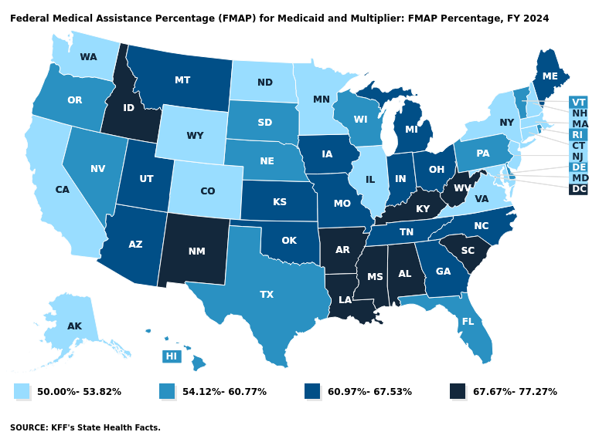
Medicaid is funded by both states and the federal government

Slide 47
Distribution of Total State Budgets SFY 2016
Source: MACPAC analysis of data in National Association of State Budget Officers 2017.

Slide 48
Medicaid Delivery Systems

Slide 49
Managed Care Organizations
Private insurance companies that are hired by the state to provide coverage for Medicaid enrollees

Slide 50
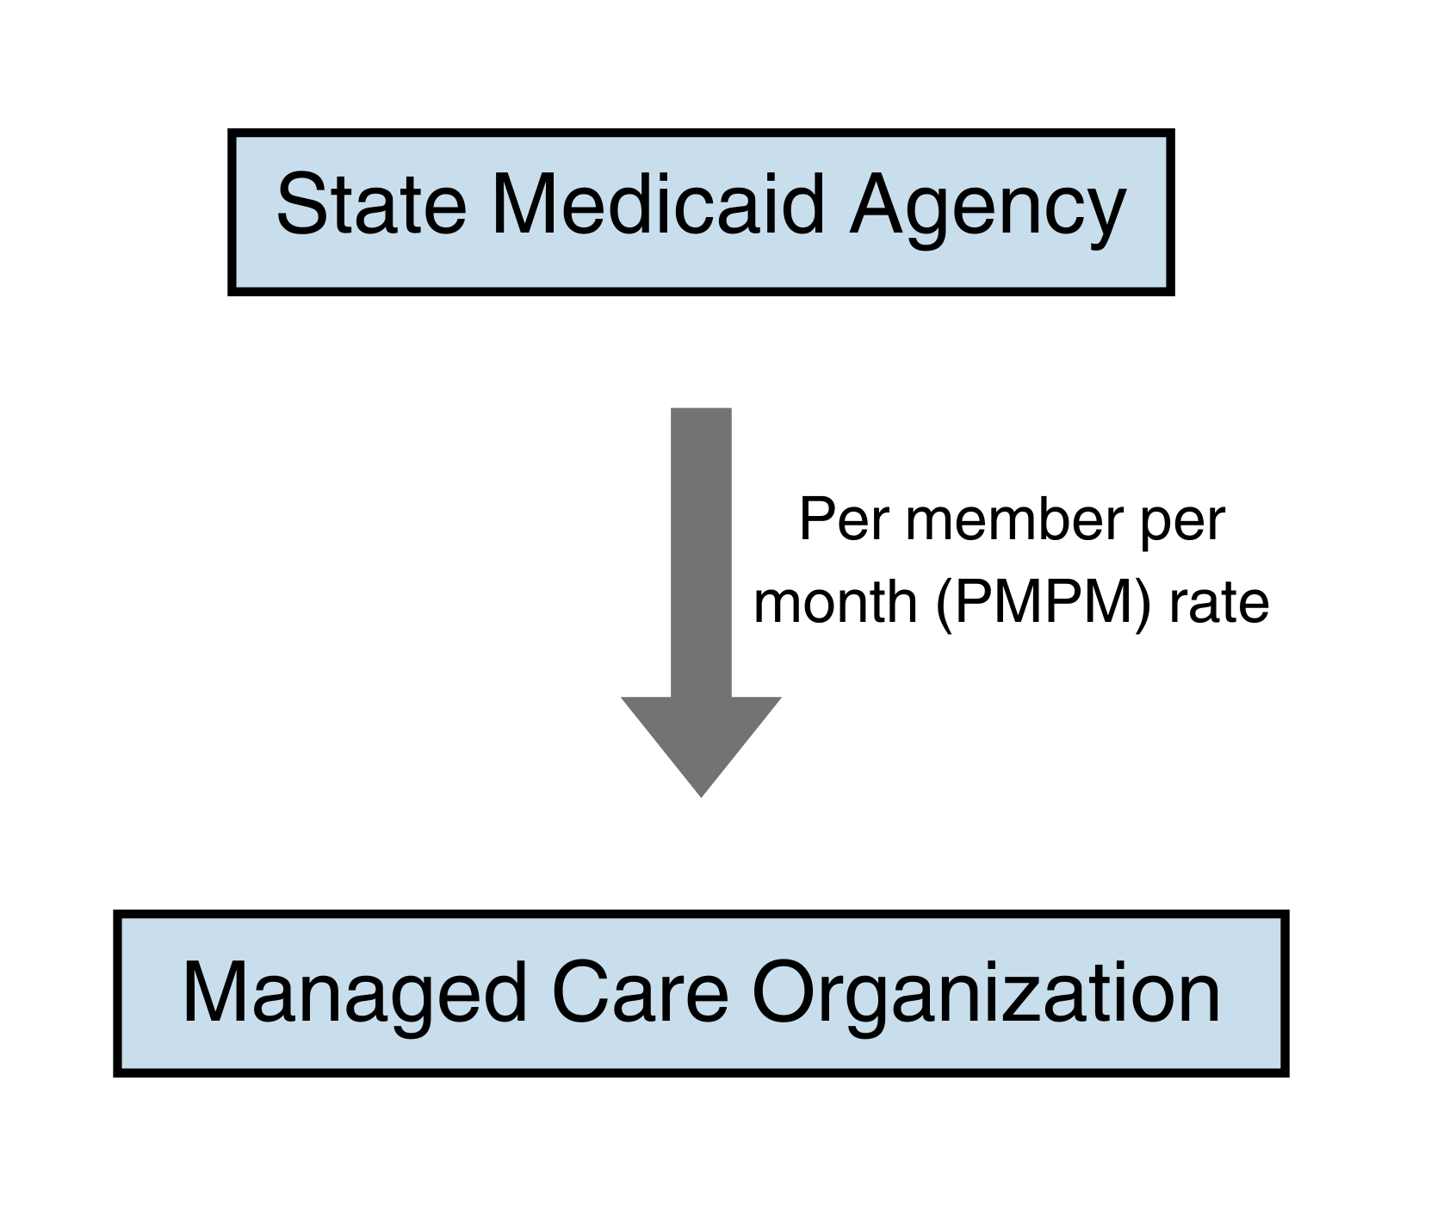
Full or Comprehensive Risk Contracts
MCOs are paid a capitation rate (per member per month rate) by the state
MCOs are responsible for providing all healthcare services

Slide 51
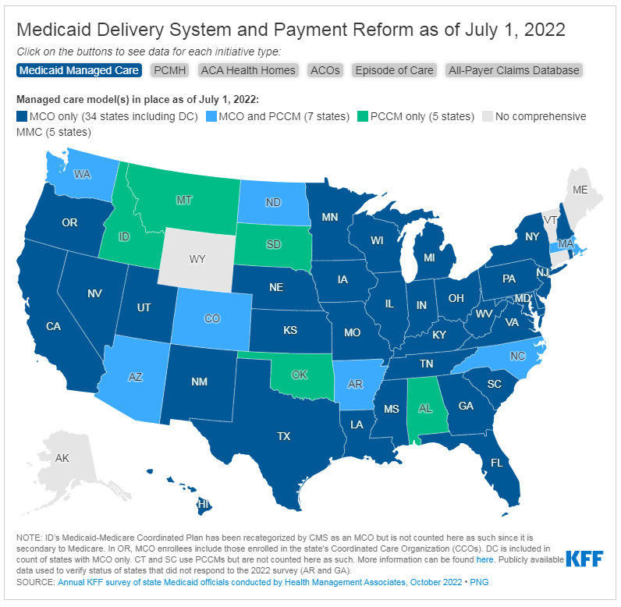

Slide 52
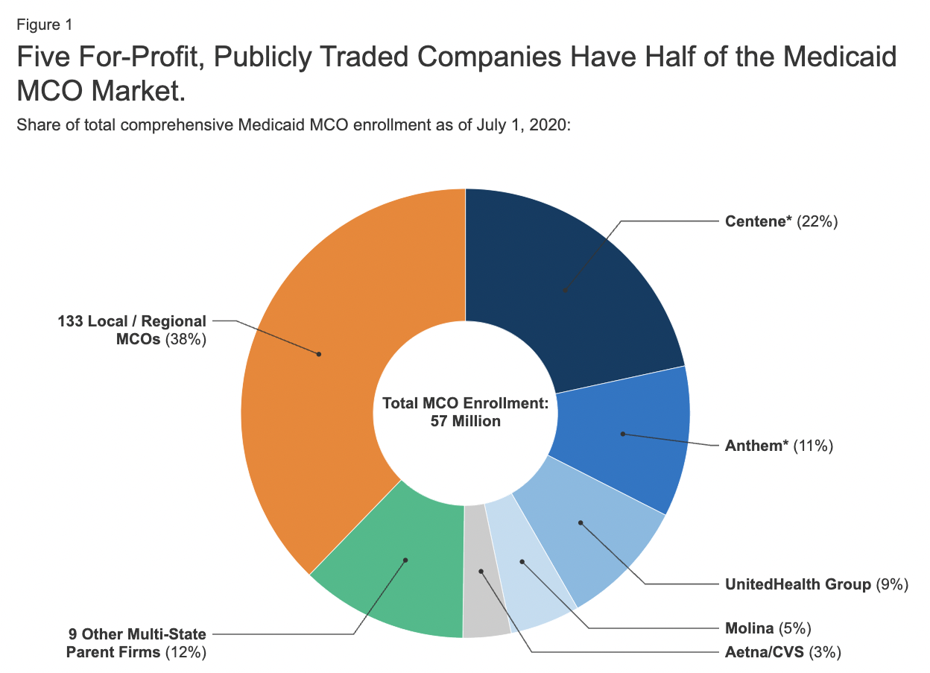
Source: A closer look at the five largest publicly traded companies operating Medicaid Managed care plans | KFF. (2023, July 6). KFF. https://www.kff.org/medicaid/issue-brief/a-closer-look-at-the-five-largest-publicly-traded-companies-operating-medicaid-managed-care-plans/

Slide 53
Value Based Payment
Reimbursing for improved outcomes (or for value) rather than just reimbursing for services
Metrics for measuring outcomes may relate to food security

Slide 54
Leaving Module 4
Task:
Identify whether or not your Medicaid program has Managed Care, who is enrolled in that managed care and what general services are covered by Managed Care.
Who are the current managed care companies?
Does your state have a different structure than managed care?
Are there any quality incentives tied to funding?
Key Takeaway
Medicaid is funded by both the federal government and states.
Many states have managed care as their delivery system and managed care organizations are selected through a competitive process.

Slide 55
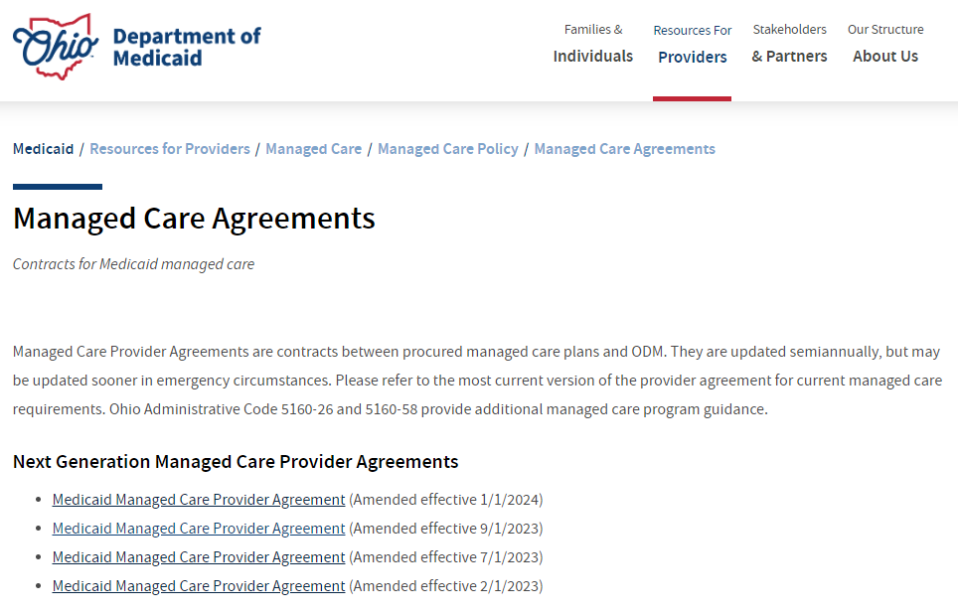
Leaving Module 4
Example Medicaid Webpage
Search Terms for Medicaid Contracts:
Food Insecurity
Health Related Social Needs
Social Determinants/Drivers of Health
SNAP
WIC
https://medicaid.ohio.gov/resources-for-providers/managed-care/mc-policy/managed-care-agreements/managed-care-agreements

Slide 56
Module 5:
Medicaid Policy Levers to Address Social Needs

Slide 57
State Plan Amendments

Slide 58
Medicaid Waivers

Slide 59
Section 1115 Demonstration Waivers
Allow states to test new approaches in Medicaid
CMS interest in waivers that address Health Related Social Needs (HRSNs), like food and housing
HRSN expenditure cannot exceed 3% of state’s annual total Medicaid spend. Up to 15% of HRSN spend can be used for infrastructure.
Allowable nutrition services include:
Nutritional counseling and education
Medically tailored meals
Food pantry stocking
Fruit and vegetable prescriptions
Source: Jantz, K. (2023, August 3). Medicaid flexibilities to address Health-Related social needs: A stakeholders guide. HealthBegins. https://healthbegins.org/medicaid-flexibilities-to-address-health-related-social-needs-a-stakeholders-guide/

Slide 60
Managed Care Flexibilities

Slide 61
Capitation Rate
Definition: a fixed amount of money that health organizations are paid, usually at a per member per month (PMPM) rate
MCOs assume risk for costs above capitation rate
They can invest in innovative solutions to improve cost and lower health costs

Slide 62
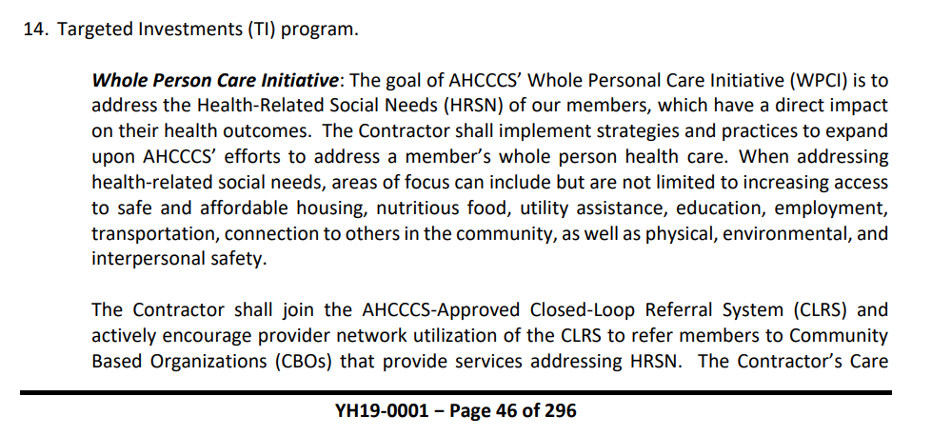
Managed Care Contract Requirements
States can create requirements for MCOs around food security in their contract, such as:
Social needs screening
Engagement in social health information exchanges
Care coordination
Community navigation
Source: Arizona Health Cost Containment System Contract YH19-0001

Slide 63
Other Ways Managed Care Can Invest in Food
Profit Reinvestment | Value Added Services (VAS) | In Lieu of Services (ILOS)

Slide 64
In Lieu of Services (ILOS)
Medically appropriate, cost-effective substitute for a state plan service
Example: MCOs can offer medically tailored meals after a hospital stay in lieu of a future hospital readmission

Slide 65
In Lieu of Services (ILOS)
Considerations:
Easier to get approval than 1115 Waivers
Only offered through managed care so certain populations may not benefit, such as some Tribal Members
Cannot cover infrastructure costs
MCOs can decide if they want to offer the service

Slide 66
Leaving Module 5
Key Takeaway
Consider:
What array of services are most important to address the food and nutrition gaps in Medicaid for children and families and what changes to the systems of food supports would be needed to deliver those benefits?
There are different options to address food insecurity in Medicaid and each has their own rules and opportunities.

