Slide 1
Medicaid and Food Security 101
A video series from the Medicaid Food Security Network

Slide 2
Module 5:
Medicaid Policy Levers to Address Social Needs

Slide 3
In this module you will learn about:
State Plan Amendments
Medicaid Waivers
Managed Care Flexibilities

Slide 4
State Plan Amendments

Slide 5
Medicaid Waivers

Slide 6
Section 1115 Demonstration Waivers
Allow states to test new approaches in Medicaid
CMS interest in waivers that address Health Related Social Needs (HRSNs), like food and housing
HRSN expenditure cannot exceed 3% of state’s annual total Medicaid spend. Up to 15% of HRSN spend can be used for infrastructure.
Allowable nutrition services include:
Nutritional counseling and education
Medically tailored meals
Food pantry stocking
Fruit and vegetable prescriptions
Source: Jantz, K. (2023, August 3). Medicaid flexibilities to address Health-Related social needs: A stakeholders guide. HealthBegins. https://healthbegins.org/medicaid-flexibilities-to-address-health-related-social-needs-a-stakeholders-guide/

Slide 7
Managed Care Flexibilities

Slide 8
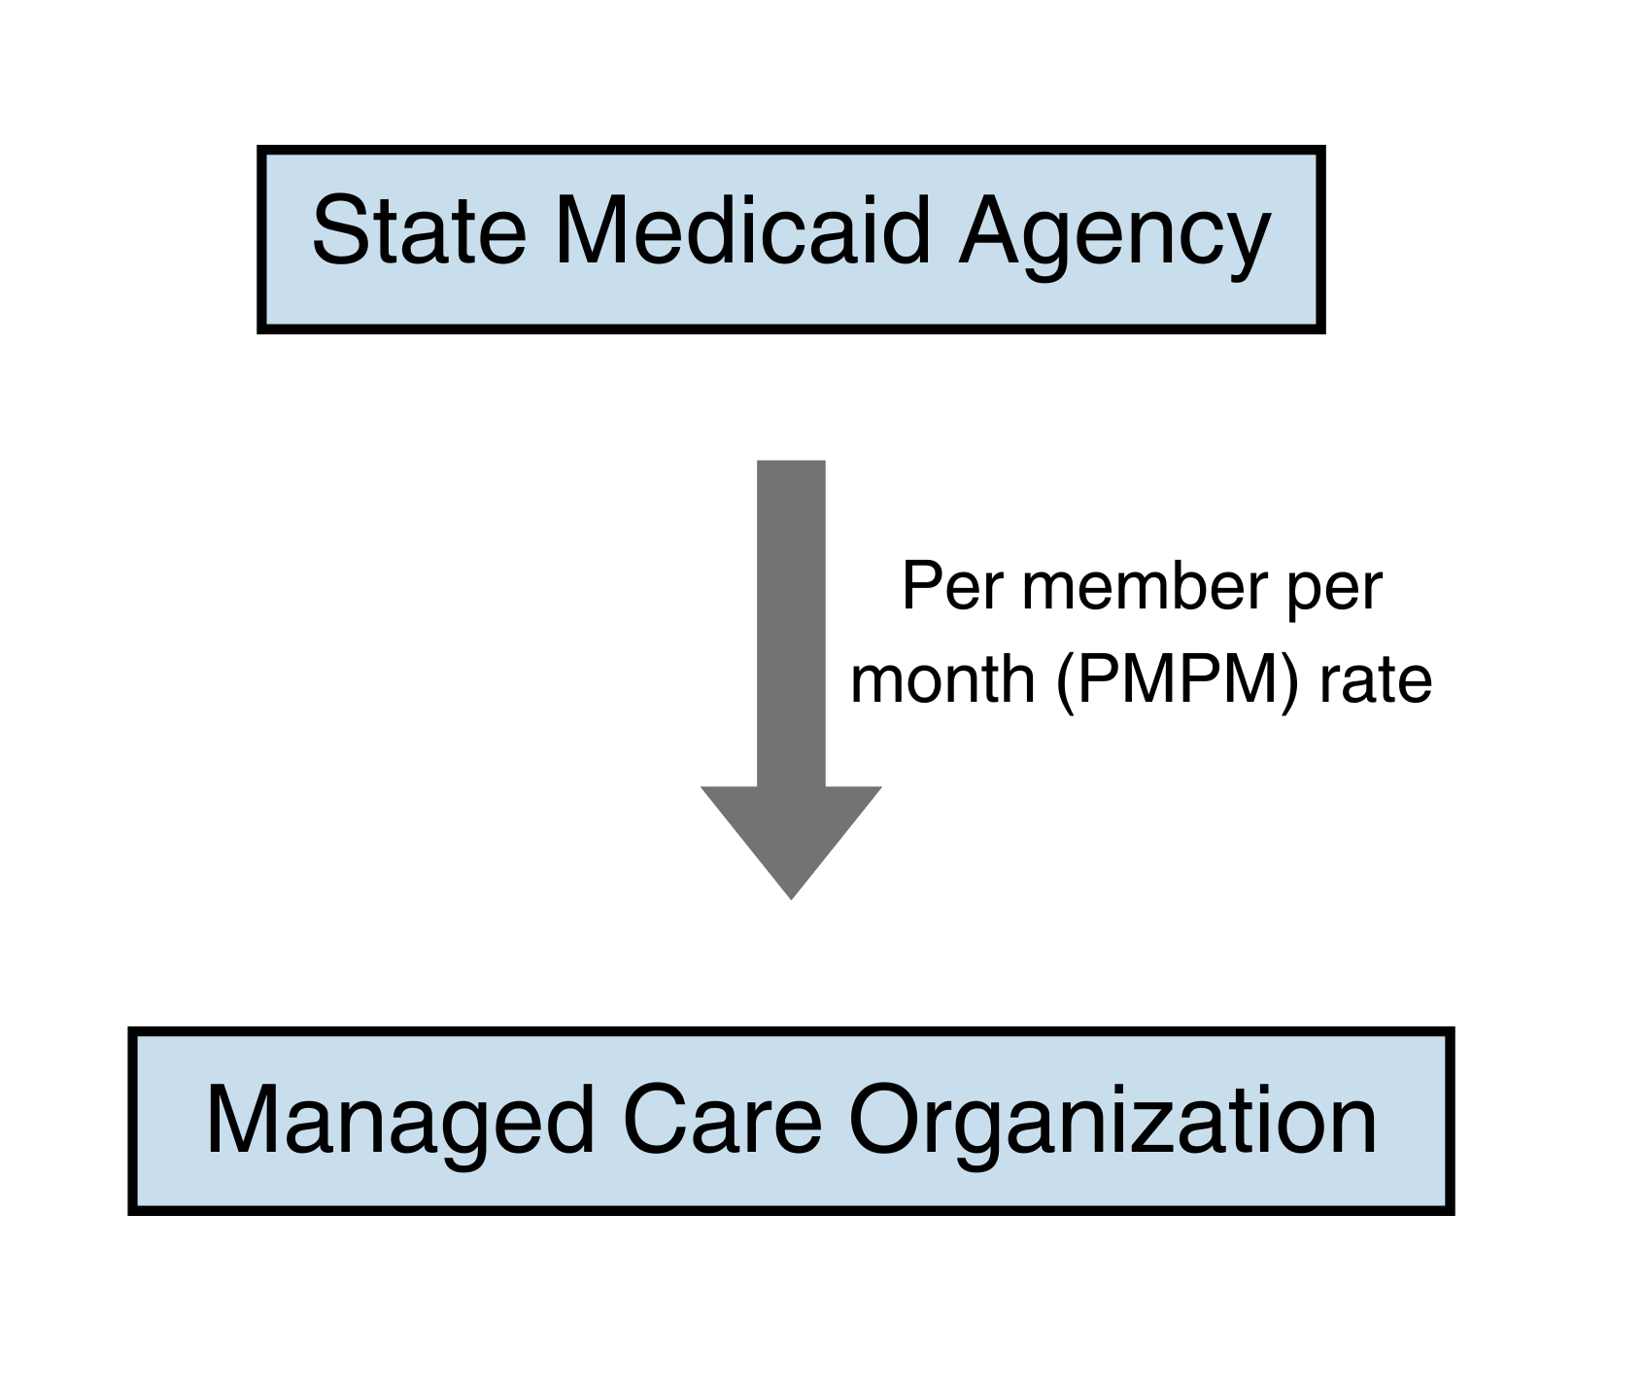
Capitation Rate
Definition: a fixed amount of money that health organizations are paid, usually at a per member per month (PMPM) rate
MCOs assume risk for costs above capitation rate
They can invest in innovative solutions to improve cost and lower health costs

Slide 9
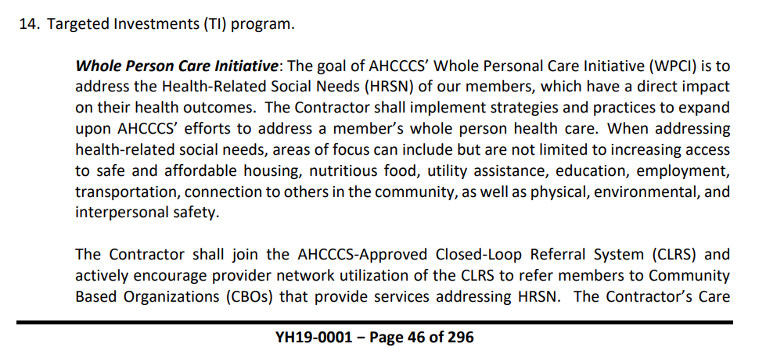
Managed Care Contract Requirements
States can create requirements for MCOs around food security in their contract, such as:
Social needs screening
Engagement in social health information exchanges
Care coordination
Community navigation
Source: Arizona Health Cost Containment System Contract YH19-0001

Slide 10
Other Ways Managed Care Can Invest in Food
Profit Reinvestment | Value Added Services (VAS) | In Lieu of Services (ILOS)

Slide 11
In Lieu of Services (ILOS)
Medically appropriate, cost-effective substitute for a state plan service
Example: MCOs can offer medically tailored meals after a hospital stay in lieu of a future hospital readmission

Slide 12
In Lieu of Services (ILOS)
Considerations:
Easier to get approval than 1115 Waivers
Only offered through managed care so certain populations may not benefit, such as some Tribal Members
Cannot cover infrastructure costs
MCOs can decide if they want to offer the service

Slide 13
Leaving Module 5
Key Takeaway
Consider:
What array of services are most important to address the food and nutrition gaps in Medicaid for children and families and what changes to the systems of food supports would be needed to deliver those benefits?
There are different options to address food insecurity in Medicaid and each has their own rules and opportunities.

