Slide 1
Medicaid Food Security Network
Quarterly Meeting
May 1, 2024
Notes:
Kelleen

Slide 2
Share the following with us in the chat:
Welcome!
Name / Pronouns
Organization & Title / Role
Notes:
Kelleen
As folks arrive, invite to introduce themselves in the chat

Slide 3
Zoom Recording: This meeting will be recorded and available on the Network website.
Housekeeping
Use the chat feature: Feel free to submit questions through the chat. We also will have time for Q&A near the end of the meeting.
Make sure you are muted: Please stay muted while others are presenting. Feel free to use the chat and/or hand raising features.
Notes:
Kelleen

Slide 4
Share out various initiatives being launched under the Medicaid Food Security Network (MFSN), including learning series, policy dashboard, partners program, and the promising strategies resource.
MFSN
Meeting
Objectives
Delve into innovative strategies and inspirational case studies related to program and policy opportunities to address food security, focusing on integrated infrastructure, data sharing, and enrollment initiatives.
Foster collaboration and engagement among attendees through breakout discussions, Q&A, and sharing of insights, aiming to generate actionable ideas and commitments for ongoing engagement with MFSN initiatives.
Notes:
Kelleen

Slide 5
Welcome & Introductions (5 min)
MFSN Initiatives Launch (15 min)
Medicaid Food Security Partners Program (15 min)
Policy and Program Opportunities Spotlight (15 min)
Breakout Room Discussions (25 min)
Breakout Rooms Share Out + Q&A (10 min)
Closing Remarks (5 min)
Meeting
Flow
Notes:
Kelleen

Slide 6
Medicaid Food Security Network
Initiatives Launch
Fill out the participant poll!
Notes:
Kathryn/Audrey: PAUSE FOR PARTICIPANT POLL!

Slide 7
Refresher: The Network’s Mission & Vision
Support anti-hunger advocates to engage, influence, and partner with state Medicaid programs and Medicaid-serving systems in adopting and implementing effective strategies to support the full spectrum of food needs of children and families enrolled in Medicaid with an emphasis on closing the enrollment gap in SNAP and WIC.
The MFSN will provide state and national anti-hunger and healthcare advocates, and other stakeholders with the infrastructure for collaboration, technical assistance, and tools for policy and advocacy. MFSN participants will be able to successfully identify, advocate for, and implement effective, state-specific policies and programs for every state Medicaid program.
Notes:
Kathryn/Audrey

Slide 8
Medicaid and Food Security 101 Learning Series
Now Available!
Notes:
Audrey
Link: https://medicaidfoodsecuritynetwork.org/medicaid-and-food-security-101/

Slide 9
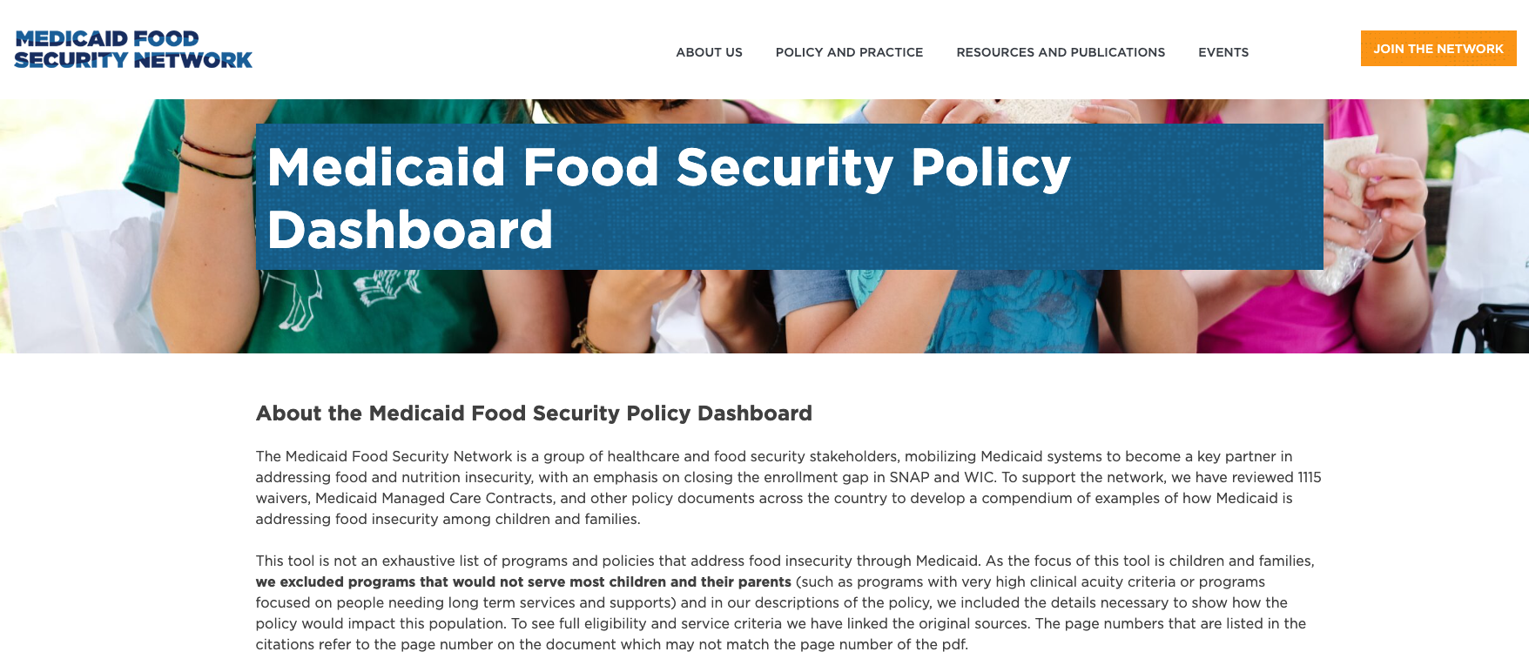
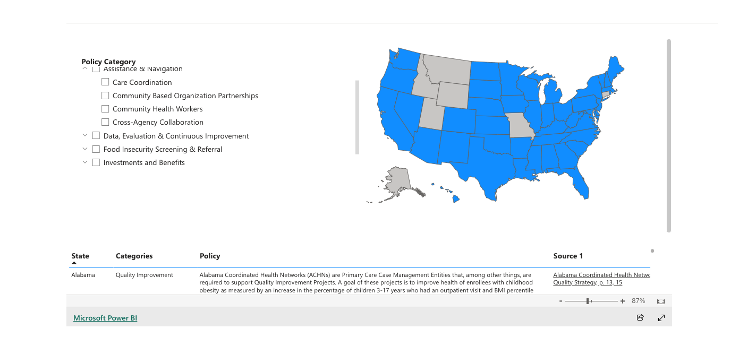
Medicaid Food Security Policy Dashboard
Now Live!
Notes:
Kathryn - talk about the why and Audrey to walk through tech
Link: https://medicaidfoodsecuritynetwork.org/dashboard/
Addressing social needs is new. We want ot help medicaid agencies overcome barriers to adopting new strategies and advocates to have a range of strategies that might work. We also know implementation is really hard so we wanted increased visibility and transparency about those requirements so that you can engage your medicaid agencies or MCOs to ensure they are having the most impact possible. We decided to begin collecting specific examples of how states are addressing food insecurity While there are many trackers of 1115 waivers. We know food advocates may be intimidated. Our hope is that 1) if you are a medicaid agency or engaging a medicaid agency you can use this tool to identify specific examples. My doing this, we hope to lessen the work states. Knowing that another specific requirements can mean it is allowable to cms, it is operationally feasible and it gives medicaid agencies and advocates an idea of how to outreach to learn more about a particular strategy 2) we want you to know what the requirements are for MCOs in your state because implementation can be hard and engagement and support from all interested and impacted stakeholders can be helpful an important. We hope that if you see a requirement that excites you or seems like an opportunity to strengthen food security in your state, that you engage your local MCOs to find out how they are implementing , how is it going. Some states have public facing deliverables where you can see the actual hope.
Tips and tricks- expand,
Let us know what is missing and if there is anything you recommend revising.

Slide 10
Promising Medicaid-Based Strategies
The Promising Medicaid-Based Strategies to Address the Food Needs of Children and Families resource provides an overview of promising strategies that food security advocates can use to collaborate with Medicaid agencies to incorporate food strategies in Medicaid Managed Care (MCO) contracts, benefit design and waivers. These strategies are designed to address the full range of food needs of Medicaid enrollees, especially children and families.
The document outlines the business case for Medicaid to address food insecurity and identify specific tactical strategies including:
FOOD INSECURITY SCREENING & REFERRAL
SNAP & WIC ENROLLMENT INFRASTRUCTURE
ASSISTANCE & NAVIGATION
DATA, EVALUATION, & CONTINUOUS IMPROVEMENT
INVESTMENTS & BENEFITS
Notes:
Kathryn
Link: https://medicaidfoodsecuritynetwork.org/wp-content/uploads/2024/04/MFSN-Promising-Strategies_4.19.2024.pdf

Slide 11
Reflection Questions:
What support do you need in advocating for policy change in your state?
Do you have any knowledge about states currently developing a managed care plan RFP or exploring an 1115 waiver?
Follow Up Discussion
We’d love to connect offline,
share your email in the chat!
Notes:
Rate setting is a huge issue. Just on a call around North Carolina and Massachusetts, If Rates are not set, its impossible to scale and do this work sustainably. There is a contineu

Slide 12
Medicaid Food Security Network
Partners Program
Notes:
Audrey

Slide 13
Medicaid Food Security Partners Program (MFSPP)
C O N G R A T U L A T I O N S
to our first MFSPP Cohort!
GEORGIA
OKLAHOMA
VIRGINIA
MICHIGAN
Notes:
Audrey to introduce
GA, VA, MI, OK

Slide 14
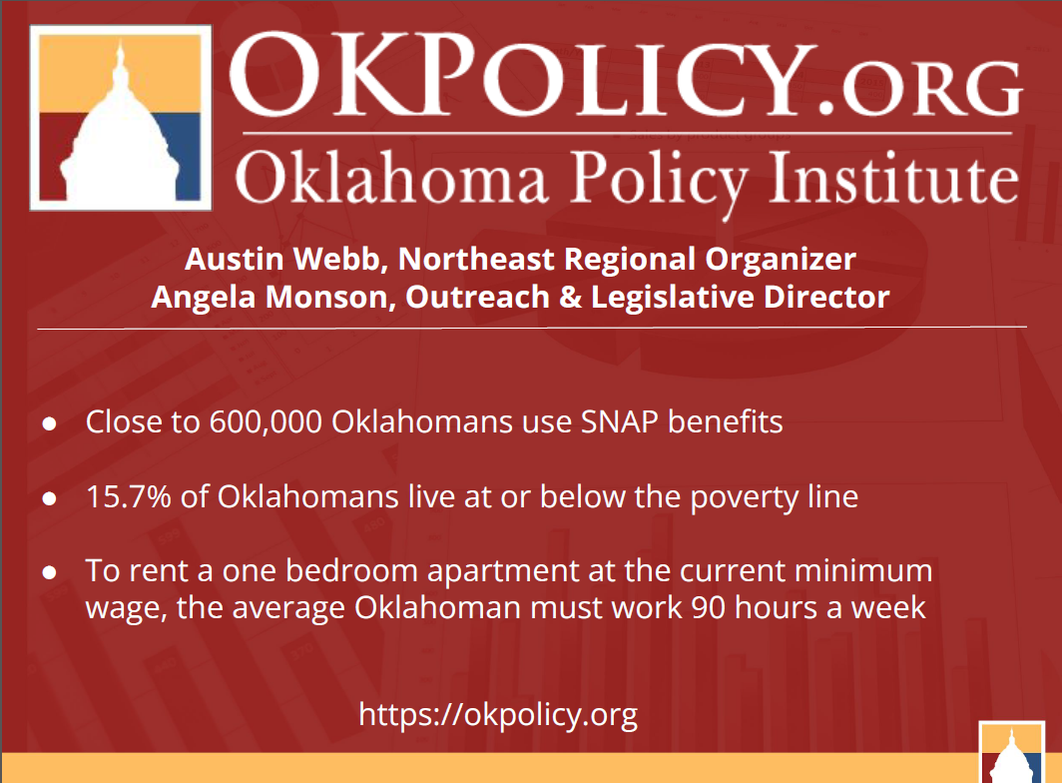

Slide 15
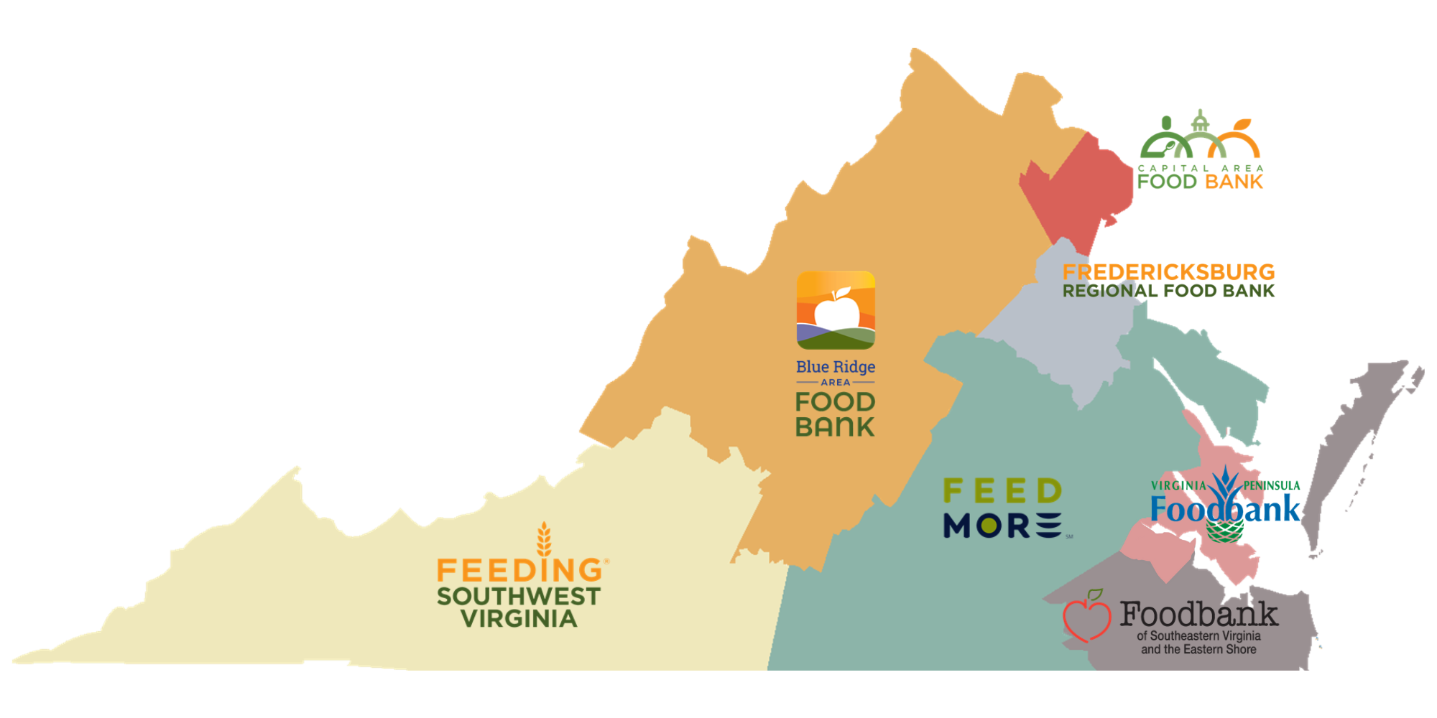
Federation of VA Food Banks
VA Food is Medicine Coalition Goals:
Share information with one another to inform the advocacy process and improve FIM programming in VA.
Coalesce around a vision for FIM policy that provides the strongest benefit to food insecure communities. Advocate to get this policy adopted and prepare to implement.
Implement reimbursable FIM programming that is equitable, appropriately scaled, high quality, practitioner informed, neighbor-centered, and community-driven.
TA/Work with MFSPP:
Catalog current FIM services in VA
Standardize definitions/services
Strengthen our FIM strategy and tie in SNAP/WIC
Guidance for partnering with plans in current ILOS opportunities
Notes:
Lead a health equity working group among food banks, and a food is medicine coalition among other food access and advocacy partners
Currently working toward an 1115 waiver - advocating and engaging Virginia Medicaid
Consulting with former Medicaid Director to advise our strategy, very focused on what’s politically feasible and how to strategically engage the right players in VA
Excited to have MFSPP here to provide the national context on what’s woking in other states and to inspire us to use this information to think more expansively about what’s possible
Our plans also just went through procurement and are eager to partner, so we’re also sorting through how to partner and advocate for $ for FIM through ILOS and enhanced benefit arrangements as we push toward a longer term solution

Slide 16
Food Bank Council of Michigan and ILOS Provision in Michigan’s Medicaid Managed Care Plans
Rebid of Michigan’s Medicaid Managed Care Health Plans in 2024; inclusion of SDoH; ILOS provision to Plans beginning with new contracts 10/1/24.
Project Goals:
To develop the most actionable and impactful ILOS RFI and subsequent state guidance for food and nutrition service providers to contract with the Medicaid Health Plans.
responding to RFI; working on written guidance with Medicaid; planning for implementation
To develop capacity for CBO food and nutrition partners to participate in ILOS.
capacity building for the state to ensure resources available for ILOS
technical assistance for CBOs interested in participating
To create a sustained feedback loop between FBCM and Michigan Medicaid for continuous improvement of food and nutrition policies and practices.
ensure that the ILOS builds from pilots to systems change
Partner state association for 7 Feeding America member food banks in Michigan
Operate a statewide Helpline for residents seeking food and other resources
Convenor of MASH, Michigan Alliance to Stop Hunger, other coalitional anti-hunger work
Hold statewide contracts for LFPA, Michigan Agricultural Surplus System grant, TEFAP/CSFP
Incubator for innovation projects including pilot healthcare programs and partnerships

Slide 17
Voices for Georgia’s Children
PROJECT GOALS
Full integration of WIC and SNAP enrollment within Georgia’s home visiting pilot.
Strong Social Determinants of Health (SDoH) language in Georgia’s upcoming Medicaid managed care contracts (in lieu of services, value-based purchasing, screeners, quality measures) to increase WIC and SNAP enrollment/utilization and Food Rx.
Identification and implementation of state agency and managed care policies to facilitate automatic enrollment and/or referrals for Medicaid beneficiaries eligible for WIC and SNAP.
Identify and educate policy makers on Medicaid SDoH 1115 waiver options that include a focus on food / nutrition supports.
ORGANIZATIONAL OVERVIEW
Georgia’s only whole-child policy research and advocacy organization advancing laws, policies, and actions that improve the lives of Georgia’s children and families.
Portfolio areas:
Early Care and Learning
Physical Health
Behavioral Healthy
Protection and Safety
JJ and School Discipline
Quality Out- Of-School Time
PROJECT STAFF
Melissa Haberlen DeWolf, JD, MPH, Research and Policy Director
Kelcie Silvio, LMSW, MPH, Senior Policy Analyst
Polly McKinney, Advocacy Director
Partnership with Georgians for a Healthy Future

Slide 18
Medicaid Food Security Network
Policy and Program Opportunities Spotlight:
Integrated SNAP, WIC, and Medicaid Infrastructure
Notes:
Jamila

Slide 19
Policy and Program Opportunities
FOOD INSECURITY SCREENING & REFERRAL
SNAP & WIC ENROLLMENT INFRASTRUCTURE
ASSISTANCE & NAVIGATION
DATA, EVALUATION, & CONTINUOUS IMPROVEMENT
INVESTMENTS & BENEFITS
Notes:
Jamila

Slide 20
How Sharing Data Builds More Efficient and Effective Benefits Systems
Jamila McLean
May 1, 2024

Slide 21
About BDT
Benefits Data Trust (BDT) is a national nonprofit harnessing the power of data, technology, and policy to provide efficient and dignified access to assistance, improving people's health and financial security.

Slide 22
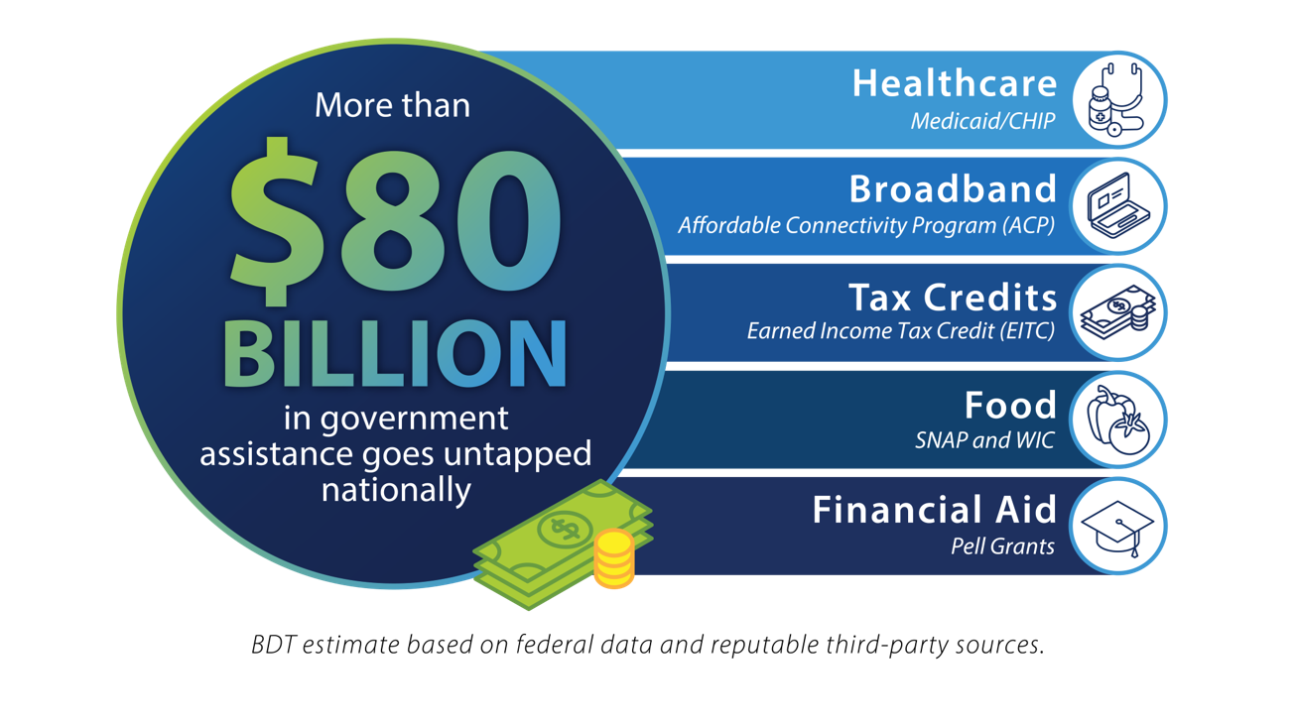
The Problem: What's Left on the Table
More than 1 in 10 Americans living in poverty ²
More than 9 million people missing out on benefits ³
Sources: 1: BDT estimate based on publicly available data for WIC, SNAP, Medicaid, CHIP, EITC, ACP, and Pell Grants
2: "Income and Poverty in the United States: 2019." United States Census Bureau.
3: BDT estimate based on publicly available data on benefit participation gaps
Notes:
Sources 1:This is a BDT-generated estimate that includes WIC,SNAP, QMB/SLMB, Medicaid, CHIP, EITC, and Pell Grants
2: "Income and Poverty in the United States: 2019." United States Census Bureau.
3: This is a BDT-generated estimate based on publicly available data on benefit participation gaps. NOTE: this is based on the fact that there are approx. 9M individuals who are eligible but not enrolled in Medicaid/CHIP alone (plus we know there's ~7M each for SNAP and WIC, but we have no good way to estimate the overlap across programs to get a count of unique individuals). Not sure how much detail we want to provide in the citation here.

Slide 23
BDT’s Data Sharing Journey
BDT was founded in 2005 through a partnership with the PA Department of Aging using data sharing, data matching and outreach to increase access to PA’s prescription assistance program for older adults.
BDT has used this model across programs with similar eligibility criteria to support other states, benefit programs, and sectors.
Executed 40 data sharing agreements (DSAs) with cities, states, healthcare entities, and institutions of higher education.

Slide 24
The Power of Data Sharing
Understand scale of participation gaps
When 4 states conducted data matches to identify individuals receiving Medicaid and/or SNAP but not WIC, they saw cross-enrollment gaps from 44-77%.¹
Uncover disparities in benefits access among certain populations
1: Jess Maneely, Zoë Neuberger, “Matching Data Across Benefit Programs Can Increase WIC Enrollment,” Center on Budget and Policy Priorities and Benefits Data Trust, April 27, 2021, Weblink.

Slide 25
The Power of Data Sharing
Conduct data-driven outreach
Outreach to Medicaid enrollees aged 60+ led to an 83% increase in SNAP participation ¹
Text outreach to individuals on Medicaid has been found to increase WIC enrollment ²
Outreach to current SNAP and Medicaid participants about the steps they need to take to maintain their benefits is a powerful way to reduce “churn” ³
Create efficiency and streamlining for agencies and residents
1: Amy Finkelstein, Matthew Notowidigdo, “Take-Up and Targeting: Experimental Evidence from SNAP,” The Quarterly Journal of Economics (Vol. 134, Issue 3), August 2019, Weblink.
2: Jess Maneely, Zoë Neuberger, “Using Data Matching and Targeted Outreach to Enroll Families with Young Children in WIC: Lessons Learned from State Pilots,” Center for Budget and Policy Priorities and Benefits Data Trust, January 5, 2021, Weblink.
3: Katie Sullivan, Sara Soka, Keith Barnes, “Text to Connect: Using Text Message Outreach to Reduce SNAP Churn,” Benefits Data Trust and Beeck Center for Social Impact + Innovation at Georgetown University, October 2021, Weblink.

Slide 26
The Building Blocks of Data Sharing: Law, Privacy and Security, and Data Sharing Agreements
Key data sharing legal questions
Federal benefits laws
SNAP, WIC, LIHEAP, Medicaid, UC
Overarching Federal privacy laws
Telephone Consumer Protection Act and Texting
Data Sharing Agreement Components

Slide 27
Key Legal Questions

Slide 28
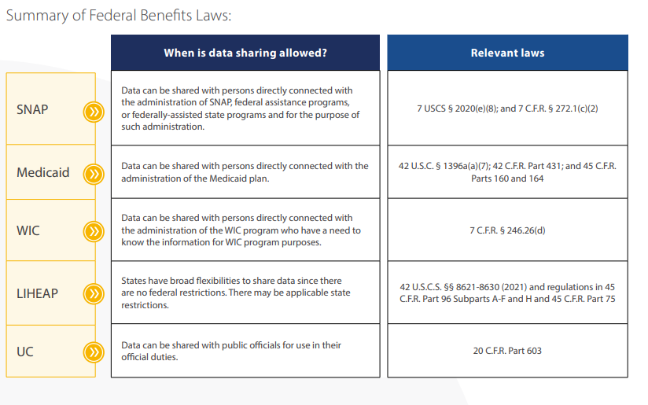
Summary of Federal Benefits

Slide 29
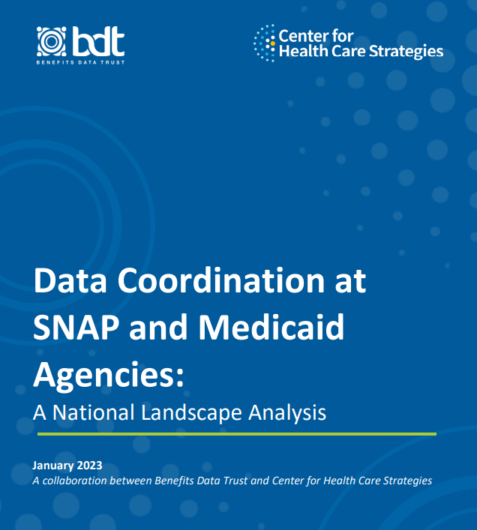
National Survey of Data Sharing between Medicaid & SNAP
BDT and the Center for Health Care Strategies’ nationwide survey of how SNAP and Medicaid within each state coordinate and share data
Check out the report here!
Notes:
BDT and CHCS collected 114 survey responses from Medicaid and SNAP programs in 46 states and the District of Columbia

Slide 30
Key Findings
Medicaid and SNAP data sharing occurs in states across the political spectrum, regardless of state size or region.
States commonly share SNAP and Medicaid data with third parties; most often with Managed Care Organizations (MCOs) and non-profits.
Integration is not necessary for data sharing across programs – states without integrated SNAP and Medicaid systems share data at almost the same rate as those with integrated systems.

Slide 31
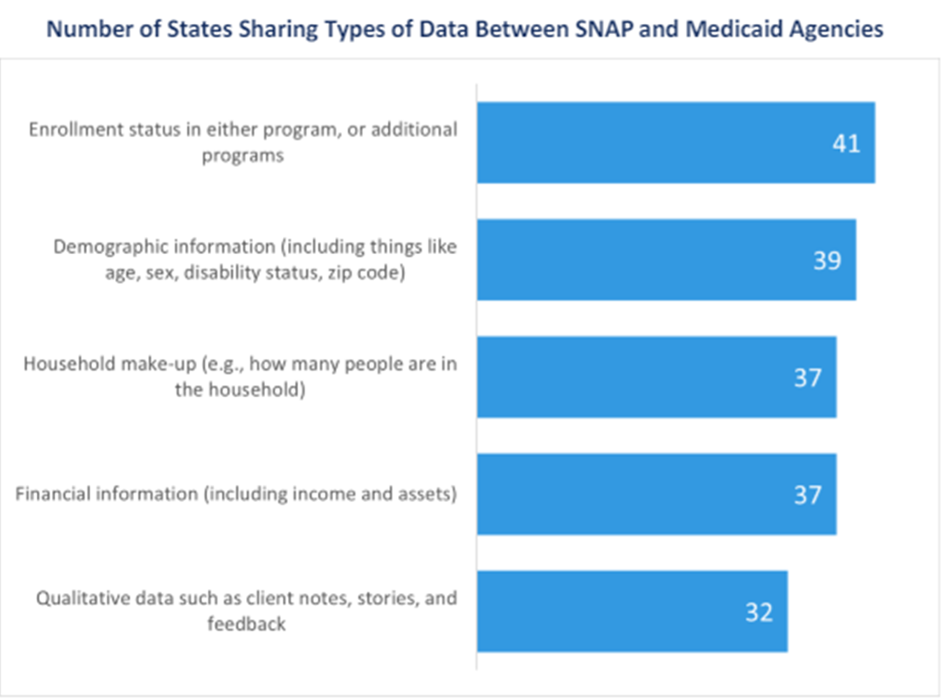
Types of Data Shared Between SNAP and Medicaid Agencies
43 states reported sharing data between SNAP and Medicaid agencies
Most states share essential data points for determining eligibility (e.g., enrollment status, income, etc.

Slide 32
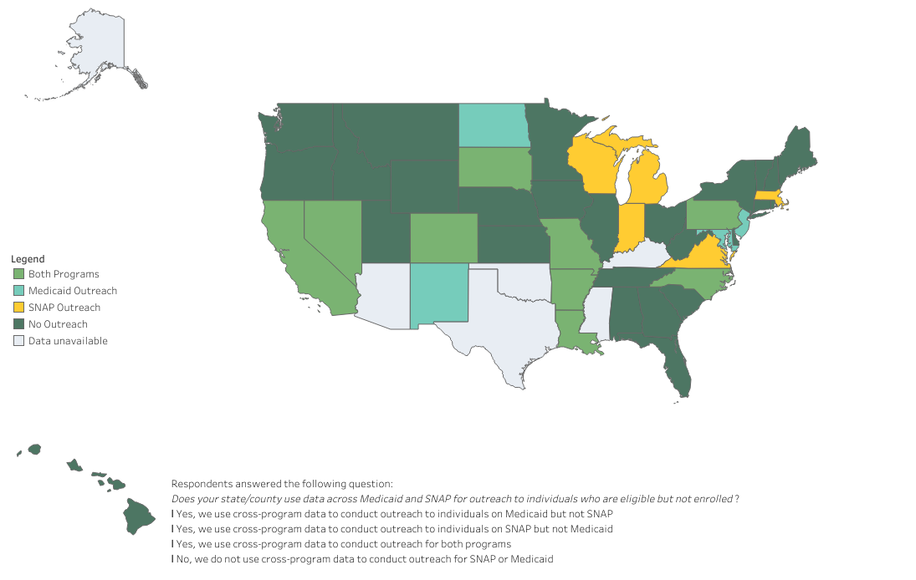
States reporting using data across Medicaid and SNAP for outreach to individuals who are eligible but not enrolled

Slide 33
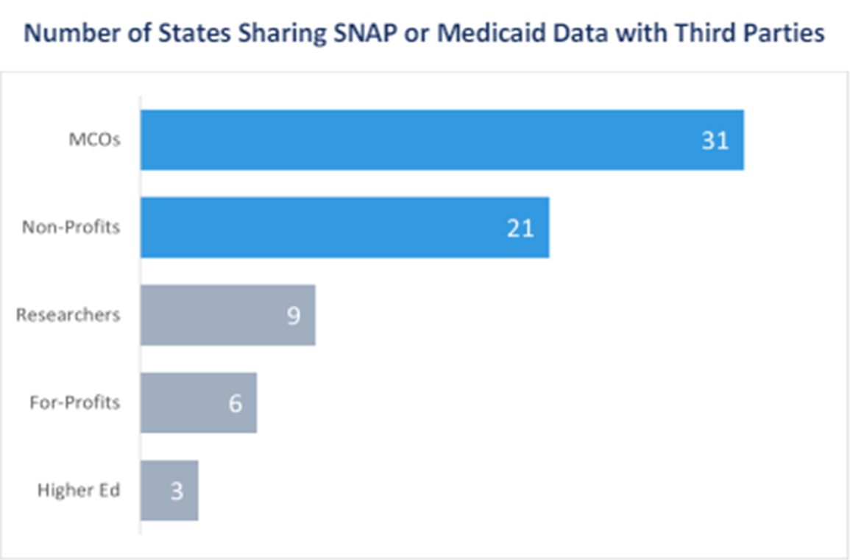
Data sharing with third parties
MCOs and non-profits are the most common third parties with which states share Medicaid and SNAP data to streamline access to benefits.
A handful of states requiring MCOs to screen individuals for food insecurity and identify individuals eligible for SNAP enrollment.

Slide 34
How is your state sharing data between Medicaid and SNAP agencies?
Check out our Interactive Map: Data Coordination at SNAP and Medicaid Agencies

Slide 35
State Examples
Colorado
Prioritizing the Needs of SNAP and Medicaid Clients and State Agencies in Colorado Through Technology Solutions
South Dakota
South Dakota’s Medicaid and SNAP Eligibility Workforce: Streamlining Data Coordination to Facilitate Enrollment
North Carolina
Using Data-Driven Outreach to Improve Access to Public Assistance Programs in North Carolina

Slide 36
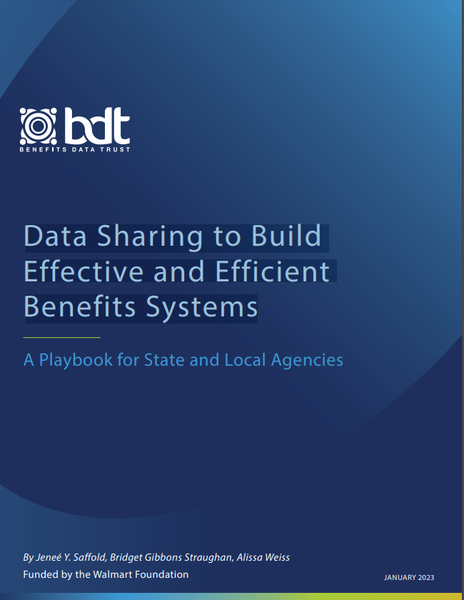
BDT’s Data Sharing Playbook
A “how-to” guide for data sharing for analysis and outreach for local/state government agencies that administer benefits + other sectors
Useful no matter where an agency is in their data sharing journey
Based on BDT’s 20 years of experience + 35 expert interviews with government and experts (including AISP)
Check out the Playbook here!

Slide 37
Breakout Room Discussions
(25 minutes)
Notes:
Laura

Slide 38
Breakout Rooms by Topic
Room 1: SNAP and Medicaid Policy - Ex. Changing SNAP income eligibility to maximum federal amount (Ki’i Powell, Benefits Data Trust) | Room 2: WIC and Medicaid Policy - Medicaid policies and practices to increase WIC take-up (Zoë Neuberger, Center on Budget and Policy Priorities) | Room 3: SNAP Technology Infrastructure - Technology for cross enrollment and data sharing - Common application (Rich Sheward, Children’s HealthWatch) | Room 4: WIC-State Agency Technology - Technology for cross enrollment and data sharing - Common application (Kathryn Jantz, HealthBegins)
Room 5: SNAP Data Sharing - Between SNAP and Medicaid agency/MCO (Julian Xie, Benefits Data Trust) | Room 6: WIC Data Sharing - Between WIC and Healthcare providers/MCOs (Katie Garfield, Center for Health Law and Policy Innovation / Elise August, Feeding America) | Room 7: Community Based Organizations and Data Sharing - How CBOs are sharing/ receiving SNAP/WIC/ Medicaid data - Closed loop referrals (Jamila McLean, Benefits Data Trust) | Room 8: Community Based Organizations and Data Sharing - How CBOs are sharing/ receiving SNAP/WIC/ Medicaid data - Closed loop referrals (Umailla Fatima, UnidosUS)
Notes:
Laura
Around 25 minutes of conversation
Each group will have a facilitator who will also be taking notes
Take a few minutes to get to know one another
Breakout rooms are connected to the presentation, focusing on - but not limited to! - specific topics or touchpoints within the larger landscape.
We’ve provided a few prompts to get the discussions going, but feel free to bring all ideas and questions to the conversation.
Facilitators, please take a look at which room number you’ve been assigned - when we open the rooms, you’ll need to self-select into the appropriate room
For the rest of the group, please review the list on the slide and select whichever room suits your interests. If you see that one room has more than X # of people, maybe consider choosing a room with fewer folks so that we can keep the group discussions small and invite more conversations
Shared notes doc:
https://docs.google.com/document/d/1EHd4c0366rzI6affG7DacC13g2mHluknQQrNotE1gH8/edit?usp=sharing

Slide 39
Q&A + Breakout Room Share Out
(10 minutes)
Notes:
Laura facilitate with breakout rooms leads (and all) participating

Slide 40
Share Out
What were highlights from your breakout room discussion?
Notes:
Laura facilitate with breakout rooms leads (and all) participating

Slide 41
Q&A
What questions can we answer?

Slide 42
Closing Remarks
Recap and Next Steps
Notes:
Laura

Slide 43
MFSN: Summary of Key Takeaways
Promising Medicaid-Based Strategies
The Promising Medicaid-Based Strategies resource is now accessible on the MFSN website and will be highlighted in the next MFSN digest.
Medicaid Food Security Partners Program
Four organizations have been awarded grants (GA, VA, MI, OK). Individual meetings with grantees took place throughout March, followed by a cohort kick-off meeting held in April.
Medicaid and Food Security 101 Modules
Video modules are LIVE on the MFSN website.
Medicaid Food Security Policy Dashboard
The Dashboard is LIVE on the MFSN website.
https://medicaidfoodsecuritynetwork.org/
Notes:
Laura

Slide 44
Upcoming Network
Quarterly Meeting
August 2024
Day/Time TBD
Notes:
Laura
Make sure signed up for MFSN Digest for announcement of date for next meeting: https://medicaidfoodsecuritynetwork.org/join/

Slide 45
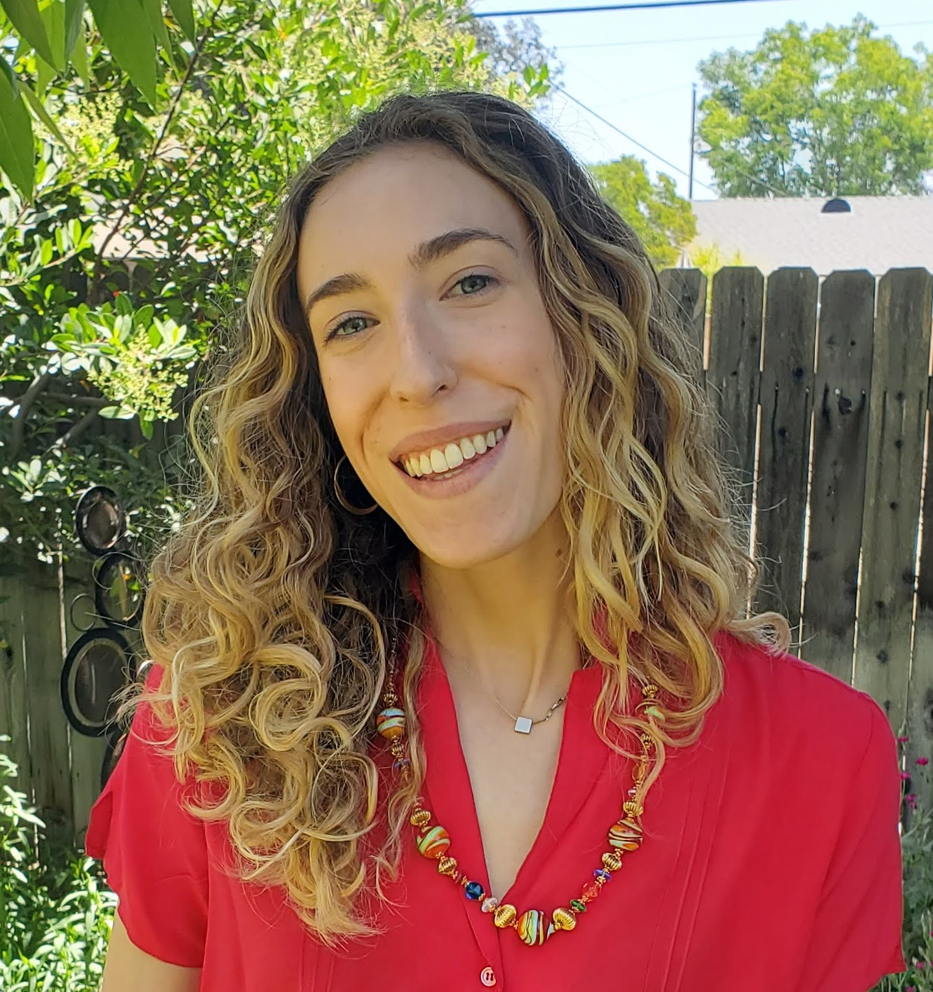
Contact
For any questions related to the MFSN, please contact:
Audrey Immel Manager, Health Systems
Share Our Strength
aimmel@strength.org
Laura Cornwell Senior Manager, Health and Medicaid
Share Our Strength
lcornwell@strength.org
MFSN@strength.org
https://medicaidfoodsecuritynetwork.org/

Slide 46
Appendix

Slide 47
Co-Design Team & MFSN Vision
We are a diverse community of inspired people, sharing our strengths, so all children and families live without hunger or poverty.
We envision an equitable world where all children, families, and communities have what they need to thrive.
Benefits Data Trust helps people live healthier, more independent lives by creating smarter, streamlined ways to access essential benefits and services. We envision a world where eligible people receive dignified and efficient assistance to pay for food, healthcare, and other critical needs.
We are a national mission-driven strategy and implementation partner that helps Medicaid-serving health systems, plans, and CBOs to move upstream and advance health equity for people and communities harmed by societal practices.

Slide 48
Steering Committee & Co-Designers
STEERING COMMITTEE
CO-DESIGN TEAM
Elise August, Feeding America
Jennifer Babcock, Association for Community Affiliated Plans
Umailla Fatima, UnidosUS
Katie Garfield, Center for Health Law and Policy Innovation
Kelly Horton, Food Research & Action Center
Jean Terranova, Community Servings
Rich Sheward, Children’s HealthWatch
Kelleen Zubick, Share Our Strength
Laura Cornwell, Share Our Strength
Audrey Immel, Share Our Strength
Jamila McLean, Benefits Data Trust
Ki’i Powell, Benefits Data Trust
Julian Xie, Benefits Data Trust
Kathryn Jantz, HealthBegins
Alejandra Cabrera, HealthBegins
Kyron Pierce, HealthBegins

Slide 49
Key Activities
CONVENE & COLLABORATE
This MFSN is the national forum to support collaboration around Medicaid’s role in food insecurity for children and families.
INFORM & INFLUENCE
The MFSN will enable important resources to be more efficiently shared and will identify and address gaps in resources needed for Medicaid policy change and effective implementation. These resources might include policy briefs, original research, and advocacy tools.
ACCELERATE POLICY CHANGE
Share learnings from the network to support state and federal level regulatory policy change that will maximize Medicaid’s impact addressing food insecurity.
ACCELERATE STATE-BASED POLICY CHANGE

Slide 50
Policy Advocacy: State Spotlights
Upcoming RFPs/States on our radar based on current their contract end date:
Alabama - Sept 2024
Arizona - Sept 2025
Hawaii - December 2026
Idaho - exploring Managed Care for children
Illinois - January 2026,
Kansas - December 2024
Louisiana - December 2027
Missouri - July 2027
Nevada - December 2027
North Carolina - June 2024
North Dakota - December 2027
Rhode Island - June 2024
Utah - June 2027
Virginia - ??
**If you have states you recommend or specific contacts in any states, please let us know.

